Slide 1
Precise frequency sources meeting 5G holdover requirements
A. Kotyukov, A. Nikonov, Yu. Ivanov
Morion, Inc. Russia
Morion, Inc.
Saint-Petersburg, Russia
www.morion.com.ru

Slide 2
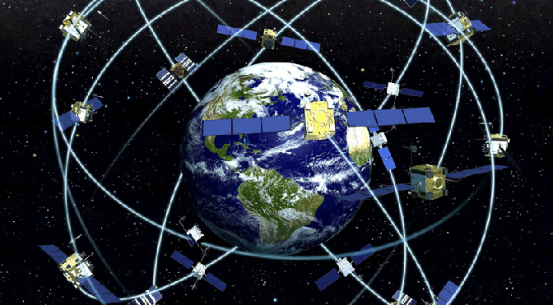
5G
TIE 400 ns and better
ULTRA STABLE OSCILLATOR
OCXO or Rb?
10 MHz DOCXO
Morion, Inc.
Saint-Petersburg, Russia
www.morion.com.ru

Slide 3
TIE causes
TIE
Frequency vs. temperature instability
AGING
Other sources of instability
Morion, Inc.
Saint-Petersburg, Russia
www.morion.com.ru

Slide 4
Temperature stability
Design of internal stage of ovenizing
Precise reference voltage
Precise temperature of internal stage
Low load sensitivity
Morion, Inc.
Saint-Petersburg, Russia
www.morion.com.ru

Slide 5
Temperature profile
2E-13 per 1ºC
Morion, Inc.
Saint-Petersburg, Russia
www.morion.com.ru

Slide 6
Long-term stability Crystal
ISO 6 class clean room
High quality quartz
Well established manufacturing processes
“Intensive aging“
Morion, Inc.
Saint-Petersburg, Russia
www.morion.com.ru

Slide 7
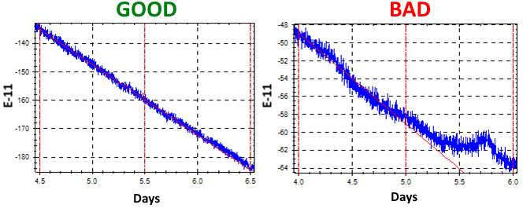
Learning systems
Long-term stability Change rate
Compensate long-term stability in holdover mode
Very low change rate should be ≤1..2E-11/day
Morion, Inc.
Saint-Petersburg, Russia
www.morion.com.ru

Slide 8
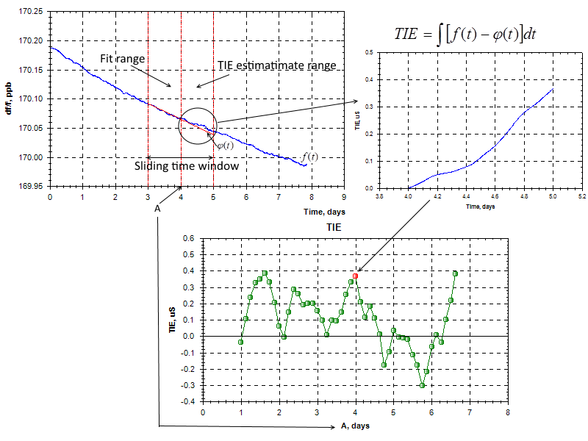
TIE estimation
Morion, Inc.
Saint-Petersburg, Russia
www.morion.com.ru

Slide 9
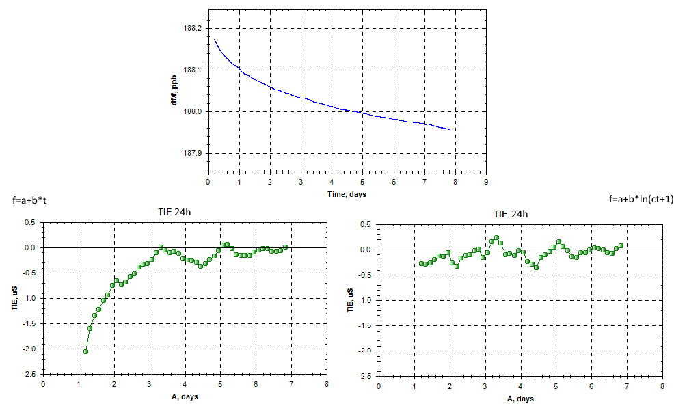
Using log fit in TIE estimation

Slide 10
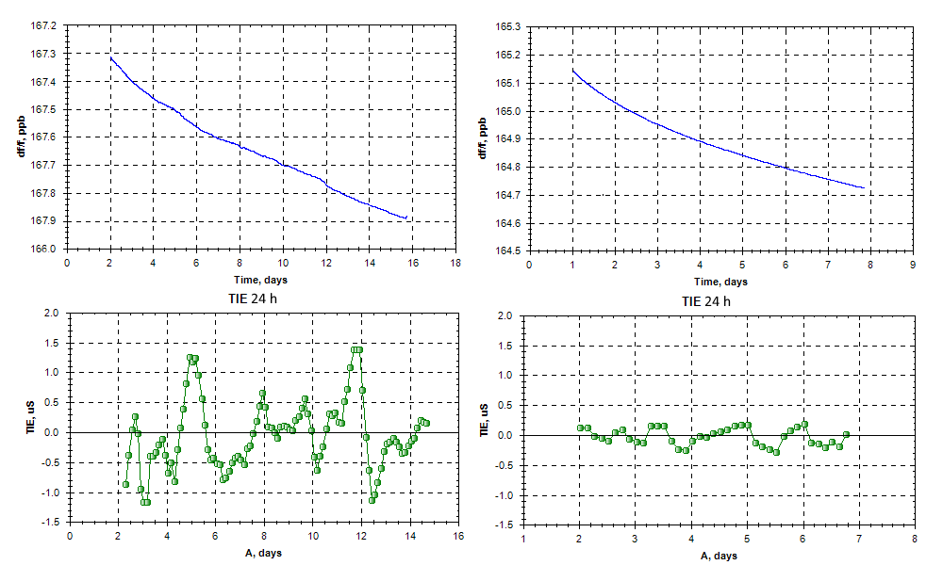
Using improved test benches

Slide 11
Oscillators for 5G
Parameter | DOCXO |  | Rubidium oscillators
 | MV336 | MV360 | FE-5650A | FE-5680A
TIE per 24 hours
at constant temperature | <400 ns | <400 ns | <100 ns | <100 ns
at ±5ºC daily changed temperature | <400 ns | <400 ns | <400 ns | <400 ns
Aging | ±2…7∙10⁻¹¹ per day |  | ±0.4∙10⁻¹¹ per day
 | ±10…30∙10⁻⁹ per year |  | ±0.2∙10⁻⁹ per year
Frequency vs temperature stability | <±0.2∙10⁻¹⁰ @-20…+70^{о}С | <±0.1∙10⁻¹⁰ @-40…+85^{о}С | <±1∙10⁻¹⁰ @ -5…+55^{о}С
Allan deviation (1 sec) | <0.1∙10⁻¹² | <2∙10⁻¹² | <14∙10⁻¹²
Power consumption:
during warm-up | <16 W | <12 W | <34 W | <36 W
steady state | <5 W | <4 W | <12 W | <15 W
Package size (mm) | 92×80×50 | 50.8×50.8×19 | 77×76×37 | 125×88×25

Slide 12
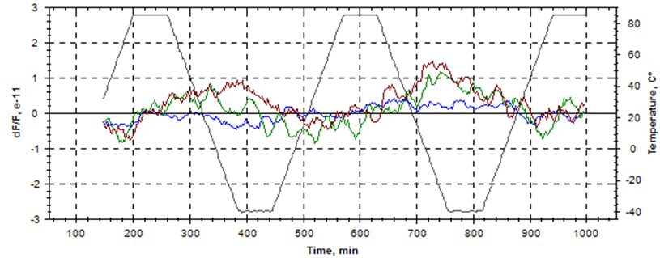
Test results.
MV360 Frequency stability vs. temperature
Morion, Inc.
Saint-Petersburg, Russia
www.morion.com.ru

Slide 13
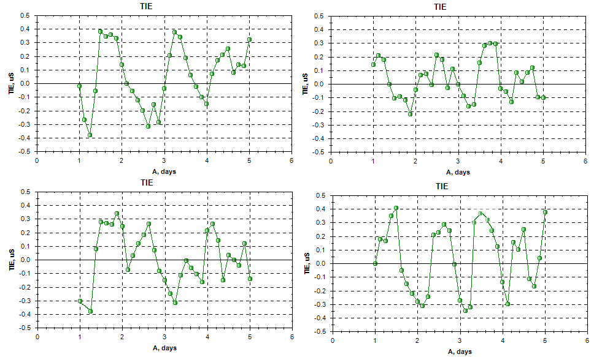
TIE test results.
MV360. TIE per 24 hours at ±5ºC
Morion, Inc.
Saint-Petersburg, Russia
www.morion.com.ru

Slide 14
TIE test results.
FE-5650A. TIE per 24 hours at const temperature
Morion, Inc.
Saint-Petersburg, Russia
www.morion.com.ru

Slide 15
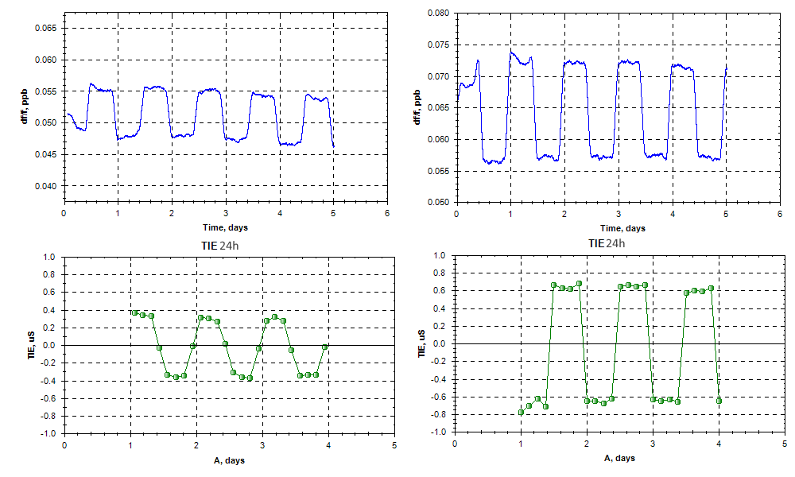
TIE test results.
FE-5650A. TIE per 24 hours at ±5ºC
Morion, Inc.
Saint-Petersburg, Russia
www.morion.com.ru

Slide 16
Thanks for your attention!
Morion, Inc.
Saint-Petersburg, Russia
www.morion.com.ru

